Slide 2
System Security CYB 309 Access Control Mechanisms
Egena Onu, PhD.
Computer Science Department,
Bingham University.

Slide 3
Access Control Mechanisms
An access control mechanism is, in simple terms, a method for implementing various access control models.
A system may implement multiple access control mechanisms.
In some modern systems, this notion of access control mechanism may be considered obsolete because the complexity of the system calls for more advanced mechanisms.
Nevertheless, here are some of the most known methods:
Access Control List
Capability Table
Access Control Matrix
Restricted Interface
Content-Dependent Access Control
Context-Dependent Access Control

Slide 4
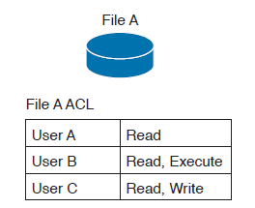
Access Control Mechanisms
Access Control List
This is the simplest way to implement a DAC-based system.
The key characteristic of an access control list is that it is assigned to the object that it is protecting.
An access control list, when applied to an object, will include all the subjects that can access the object and their specific permissions.

Slide 5
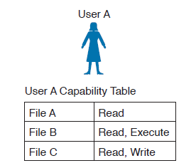
Access Control Mechanisms
Capability Table
This is a collection of objects that a subject can access, together with the granted permissions.
The key characteristic of a capability table is that it’s subject centric instead of being object centric, like in the case of an access control list.

Slide 6
Access Control Mechanisms
Access control matrix (ACM)
This is an access control mechanism that is usually associated with a DAC-based system.
An ACM includes three elements: the subject, the object, and the set of permissions.
Each row of an ACM is assigned to a subject, while each column represents an object.
The cell that identifies a subject/object pair includes the permission that subject has on the object.
An ACM could be seen as a collection of access control lists or a collection of capabilities table, depending on how you want to read it.

Slide 7
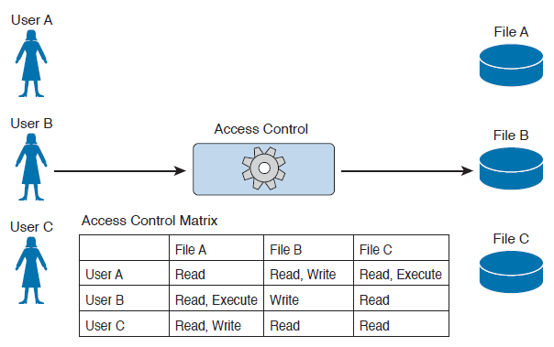
Access Control Mechanisms
Access control matrix (ACM)
This is an access control mechanism that is usually associated with a DAC-based system.
An ACM includes three elements: the subject, the object, and the set of permissions.
Each row of an ACM is assigned to a subject, while each column represents an object.
The cell that identifies a subject/object pair includes the permission that subject has on the object.
An ACM could be seen as a collection of access control lists or a collection of capabilities table, depending on how you want to read it.

Slide 8
Access Control Mechanisms
Restricted interface
This type of control limits the operations a subject can perform on an object by not providing that option on the interface that the subject uses to access the object.
Typical examples of this type of control are menus, shells, physical constraint interfaces, and so on.
For example, a menu could offer more options if a user is a system administrator, and fewer options if the user is a guest.
Content-Dependent Access Control
This type of control uses the information (content) within a resource to make an authorization decision.
This type of control is generally used in database access controls. A typical example is a database view.

Slide 9
Access Control Mechanisms
Context-dependent access control
This type of control uses contextual information to make an access decision, together with other information such as the identity of the subject.
For example, a system implementing a context-dependent control may look at events preceding an access request to make an authorization decision.
A typical system that uses this type of control is a stateful firewall, configured with the Zone-Based Firewall feature, where a packet is allowed or denied based on the information related to the session the packet belongs to.

Slide 10
Identity and Access Control Implementation
Identity and access control implementation focuses on managing user identities and access permissions on a computer network.
Policies, processes, and technologies may differ from organisation to organisations.
However, the goal of any identity and access control implementation initiative is to ensure that the right users and devices can access the right resources for the right reasons at the right time.
Identity and access control streamlines access control in complex, multi-cloud environments.
Today, corporate networks connect to on-premises, remote, and cloud-based (SaaS) apps and data sources.

Slide 11
Identity and Access Control Implementation
A wide range of users need access to these resources for various purposes, including human users (employees, customers, contractors) and non-human users (bots, IoT devices, automated workloads, APIs).
Identity and access control implementation systems allow companies to assign a single digital identity and set access privileges for each user.
That way, only authorized users can handle company resources, and they can only use those resources in ways the company permits.
Several methods, technologies, and protocols can be used to implement identity and access technical controls.

Slide 12
Identity and Access Control Implementation
The most common implementations include:
Authentication, Authorisation and Accounting
Port-Based Access Control
Network Access Control List and Firewalling
Identity Management and Profiling
Network Segmentation
Intrusion Detection and Prevention
Antivirus and Antimalware

Slide 13
Identity and Access Control Implementation
Authentication, Authorisation and Accounting
Several protocols are used to grant access to networks or systems, provide information about access rights, and provide capabilities used to monitor, audit, and account for user actions once authenticated and authorized.
These protocols are called authentication, authorization, and accounting (AAA) protocols.
The most well-known AAA protocols are:
RADIUS – Remote Access Dial-In User Service
TACACS+ - Terminal Access Control System Plus
Diameter
However, TACACS+ is a proprietary protocol that is owned by CISCO Inc. and operates only on CISCO IOS.

Slide 14
Identity and Access Control Implementation
Authentication, Authorisation and Accounting
RADIUS
RADIUS stands for Remote Authentication Dial-In User Service. It is an AAA protocol mainly used to provide network access services.
RADIUS is a client-server protocol and software that enables remote access servers to communicate with a central server to authenticate dial-in users and authorize their access to the requested system or service.
RADIUS was originally designed to support large number of users connecting remotely to internet service providers (ISPs) or corporate networks via modem pools or other point-to-point serial line links.
RADIUS is now commonly used for remote access across different types of networks, including wireless networks, Ethernet networks and other types of remote user access through the internet.
RADIUS can support several types of authentication mechanisms, such as PPP PAP, CHAP, and EAP.

Slide 15
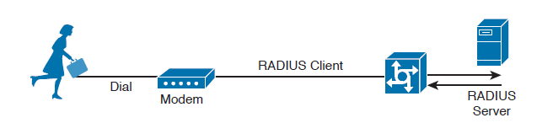
Identity and Access Control Implementation
Authentication, Authorisation and Accounting
RADIUS
RADIUS stands for Remote Authentication Dial-In User Service.
It is an AAA protocol mainly used to provide network access services.
RADIUS is a client-server protocol and software that enables remote access servers to communicate with a central server to authenticate dial-in users and authorize their access to the requested system or service.
RADIUS was originally designed to support large numbers of users connecting remotely to internet service providers (ISPs) or corporate networks via modem pools or other point-to-point serial line links.
RADIUS is now commonly used for remote access across different types of networks, including wireless networks, Ethernet networks and other types of remote user access through the internet.
RADIUS can support several types of authentication mechanisms, such as PPP PAP, CHAP, and EAP.

Slide 16
Identity and Access Control Implementation
Authentication, Authorisation and Accounting
RADIUS Operation
RADIUS operates in most cases over UDP protocol port 1812 for authentication and authorization, and port 1813 for accounting, which are the officially assigned ports for this service.
In earlier implementations, RADIUS operated over UDP port 1645 for authentication and authorization, and port 1646 for accounting. The authentication and authorization phase consists of two messages:
The RADIU client/network access server (NAS) sends an ACCESS-REQUEST to the RADIUS server that includes the user identity, the password, and other information about the requestor of the access (for example, the IP address).
The RADIUS server may reply with three different messages:
ACCESS-ACCEPT if the user is authenticated. This message will also include in the Attribute field authorization information and specific vendor information used by the access server to provide services.
ACCESS-REJECT if access for the user is rejected.
ACCESS-CHALLENGE if additional information is needed, RADIUS server needs to send an additional challenge to the access server before authenticating the user. The ACCESS-CHALLENGE will be followed by a new ACCESS-REQUEST message.

Slide 17
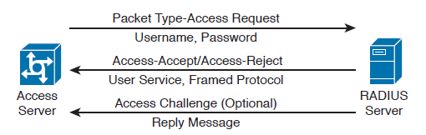
Identity and Access Control Implementation
Authentication, Authorisation and Accounting
RADIUS Operation
The access server sends an ACCESS-REQUEST to the RADIUS server that includes the user identity, the password, and other information about the requestor of the access (for example, the IP address).
The RADIUS server may reply with three different messages:
ACCESS-ACCEPT if the user is authenticated. This message will also include in the Attribute field authorization information and specific vendor information used by the access server to provide services.
ACCESS-REJECT if access for the user is rejected.
ACCESS-CHALLENGE if additional information is needed, RADIUS server needs to send an additional challenge to the access server before authenticating the user. The ACCESS-CHALLENGE will be followed by a new ACCESS-REQUEST message.

Slide 18
Identity and Access Control Implementation
Authentication, Authorisation and Accounting
RADIUS Operation
The accounting exchange consists of two messages:
ACCOUNTING-REQUEST and ACCOUNTING-RESPONSE. Accounting can be used, for example, to specify how long a user has been connected to the network (the start and stop of a session).
The RADIUS exchange is authenticated by using a shared secret key between the access server and the RADIUS server. Only the user password information in the ACCESSREQUEST is encrypted; the rest of the packets are sent in plaintext .

Slide 19
Identity and Access Control Implementation
Authentication, Authorisation and Accounting
Diameter
Diameter is an access control protocol defined by the IETF to provide AAA services.
The main reason for the introduction of the Diameter protocol is the capability to work with applications that enable protocol extension.
The main Diameter application is called Diameter base and it implements the core of the Diameter protocol.
Other applications are Mobile IPv4 Application, Network Access Server Application, Diameter Credit-Control Application, and so on. Each application specifies the content of the information exchange in Diameter packets.
For example, to use Diameter as AAA protocol for network access, the Diameter peers will use the Diameter Base Application and the Diameter Network Access Server Application.

Slide 20
Identity and Access Control Implementation
Authentication, Authorisation and Accounting
Diameter
The Diameter header field Application ID indicates the ID of the application.
Each application, including the Diameter Base application, uses command code to identify specific application actions.
Diameter is a peer-to-peer protocol, and entities in a Diameter context are called Diameter nodes.
A Diameter node is defined as a host that implements the Diameter protocol.

Slide 21
Identity and Access Control Implementation
Authentication, Authorisation and Accounting
Diameter
The protocol is based on two main messages: a REQUEST, which is identified by setting the R bit in the header, and an ANSWER, which is identified by unsetting the R bit.
Each message will include a series of attribute/value pairs (AVPs) that include application-specific information.
In its basic protocol flow, after the transport layer connection is created, the Diameter initiator peer sends a Capability-Exchange-Request (CER) to the other peer that will respond with a Capability-Exchange-Answer (CEA).
The CER can include several AVPs, depending on the application that is requesting a connection. Once the capabilities are exchanged, the Diameter applications can start sending information.

Slide 22
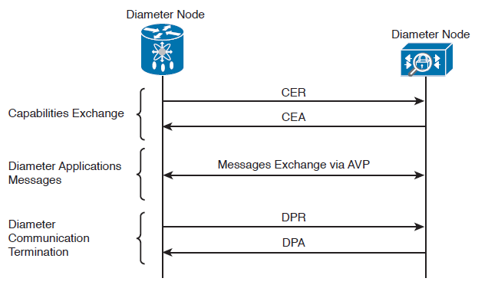
Identity and Access Control Implementation
Authentication, Authorisation and Accounting
Diameter
The protocol is based on two main messages: a REQUEST, which is identified by setting the R bit in the header, and an ANSWER, which is identified by unsetting the R bit.
Each message will include a series of attribute/value pairs (AVPs) that include application-specific information.
In its basic protocol flow, after the transport layer connection is created, the Diameter initiator peer sends a Capability-Exchange-Request (CER) to the other peer that will respond with a Capability-Exchange-Answer (CEA).
The CER can include several AVPs, depending on the application that is requesting a connection. Once the capabilities are exchanged, the Diameter applications can start sending information.

Slide 23
Identity and Access Control Implementation
Authentication, Authorisation and Accounting
Diameter
The protocol is based on two main messages: a REQUEST, which is identified by setting the R bit in the header, and an ANSWER, which is identified by unsetting the R bit.
Each message will include a series of attribute/value pairs (AVPs) that include application-specific information.
In its basic protocol flow, after the transport layer connection is created, the Diameter initiator peer sends a Capability-Exchange-Request (CER) to the other peer that will respond with a Capability-Exchange-Answer (CEA).
The CER can include several AVPs, depending on the application that is requesting a connection. Once the capabilities are exchanged, the Diameter applications can start sending information.

Slide 24
Identity and Access Control Implementation
Authentication, Authorisation and Accounting
Diameter
Diameter also implements a keep-alive mechanism by using a Device-Watchdog-Request (DWR), which needs to be acknowledged with a Device-Watchdog-Answer (DWA).
The communication is terminated by using a Disconnect-Peer-Request (DPR) and Disconnect-Peer-Answer (DPA). Both the Device-Watchdog and Disconnect-Peer can be initiated by both parties.

Slide 25
Identity and Access Control Implementation
Authentication, Authorisation and Accounting
Diameter
Diameter provides user authentication service for network access through the following protocol flow:
The initiator peer, the access server, sends a CER message with the Auth-Application-Id AVP set to 1, meaning that it supports authentication capabilities.
The Diameter server sends a CEA back to the access server with the Auth-Application-Id AVP set to 1.
The access server sends an AA-Request (AAR) to the Diameter server that includes information about the user authentication, such as username and password.
The access server will reply with an AA-Answer (AAA) message including the authentication results.

Slide 26
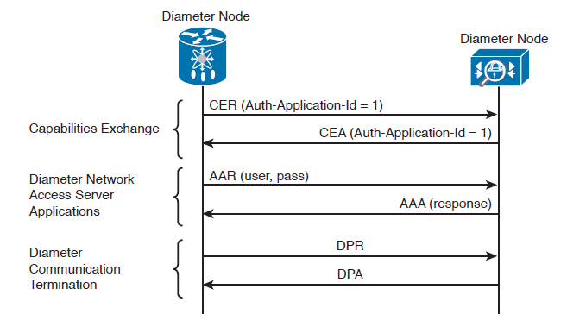
Identity and Access Control Implementation
Authentication, Authorisation and Accounting
Diameter
Diameter provides user authentication service for network access through the following protocol flow:
The initiator peer, the access server, sends a CER message with the Auth-Application-Id AVP set to 1, meaning that it supports authentication capabilities.
The Diameter server sends a CEA back to the access server with the Auth-Application-Id AVP set to 1.
The access server sends an AA-Request (AAR) to the Diameter server that includes information about the user authentication, such as username and password.
The access server will reply with an AA-Answer (AAA) message including the authentication results.

Slide 27
Identity and Access Control Implementation
Port-Based Access Control
Port-based access controls are associated with a specific access port, such as an access layer switch port, for example.
The idea behind this type of control is to allow or deny a device that is physically connected to a network port with access to a specific resource.
There are two types of port-based access control implementation that are discussed here:
Port security and
802.1x.
Both types of access controls are based on the ABAC model (sometimes also described as identity-based or rule-based access control).

Slide 28
Identity and Access Control Implementation
Port-Based Access Control
Port Security
Port security is a security feature used to provide access control by restricting the medium access control (MAC) addresses that can be connected to a given port.
This differs from a MAC access list because it works only on the source MAC address without matching the MAC destination.
Port security works by defining a pool of MAC addresses that are allowed to transmit on a device port. The pool can be statically defined or dynamically learned.
Compared to a MAC access list, which would need to be implemented on each port and have static entries, the dynamically learned method reduces the administrative overhead related to the port access control implementation.

Slide 29
Identity and Access Control Implementation
Port-Based Access Control
Port Security
When a frame is received on the port, the port security feature checks the source MAC address of the frame. If it matches an allowed MAC address, the frame will be forwarded; otherwise, the frame will be dropped.
In addition to drop frames coming from an unauthorized MAC address, port security will raise a security violation.
A security violation is raised under the following circumstances:
If a MAC address that is configured or dynamically learned on one port is seen on a different port in the same VLAN. This is referred to as a MAC move.
If the maximum number of MAC addresses allowed for a port is reached and the incoming MAC is different from the one already learned.

Slide 30
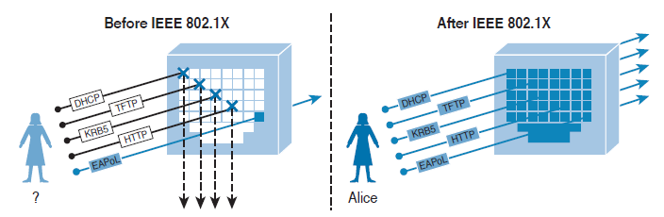
Identity and Access Control Implementation
Port-Based Access Control
802.1x
802.1x is an IEEE standard that is used to implement port-based access control.
In simple terms, an 802.1x access device will allow traffic on the port only after the device has been authenticated and authorized.
This figure shows an example of traffic allowed before and after an 802.1x authentication and authorization.

Slide 31
Identity and Access Control Implementation
Port-Based Access Control
802.1x
In an 802.1x-enabled network, three main roles are defined:
Authentication server:
An entity that provides an authentication service to an authenticator. The authentication server determines whether the supplicant is authorized to access the service.
This is sometimes referred to as the Policy Decision Point (PDP).
Supplicant:
An entity that seeks to be authenticated by an authenticator. For example, this could be a client laptop connected to a switch port.
Authenticator:
An entity that facilitates authentication of other entities attached to the same LAN. This is sometimes referred to as the Policy Enforcement Point (PEP). Switches and access points are examples of authenticators.

Slide 32
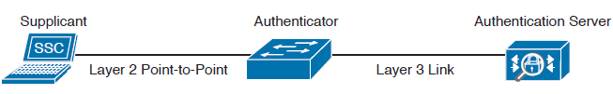
Identity and Access Control Implementation
Port-Based Access Control
802.1x
In an 802.1x-enabled network, three main roles are defined:
Authentication server:
An entity that provides an authentication service to an authenticator. The authentication server determines whether the supplicant is authorized to access the service.
This is sometimes referred to as the Policy Decision Point (PDP).
Supplicant:
An entity that seeks to be authenticated by an authenticator. For example, this could be a client laptop connected to a switch port.
Authenticator:
An entity that facilitates authentication of other entities attached to the same LAN. This is sometimes referred to as the Policy Enforcement Point (PEP). Switches and access points are examples of authenticators.

Slide 33
Identity and Access Control Implementation
Port-Based Access Control
802.1x
802.1x uses the following protocols:
Extensible Authentication Protocol over LAN (EAPoL): An encapsulation defined in 802.1x that’s used to encapsulate EAP packets to be transmitted from the supplicant to the authentication server.
Extensible Authentication Protocol (EAP): An authentication protocol used between the supplicant and the authentication server to transmit authentication information.
RADIUS or Diameter: The AAA protocol used for communication between the authenticator and authentication server.

Slide 34
Identity and Access Control Implementation
Port-Based Access Control
802.1x
The 802.1x port-based access control includes four phases:
Session initiation
The session can be initiated either by the authenticator with an EAP-Request-Identity message or by the supplicant with an EAPoL-Start message.
Before the supplicant is authenticated and the session authorized, only EAPoL and Spanning Tree Protocol (STP) traffic is allowed on the port from the authenticator.

Slide 35
Identity and Access Control Implementation
Port-Based Access Control
802.1x
Session authentication
The authenticator extracts the EAP message from the EAPoL frame and sends a RADIUS Access-Request to the authentication server, adding the EAP information in the AV pair of the RADIUS request.
The authenticator and the supplicant will use EAP to agree on the authentication method (for example, EAPTLS). Depending on the authentication method negotiated, the supplicant may provide a password, a certificate, a token, and so on.

Slide 36
Identity and Access Control Implementation
Port-Based Access Control
802.1x
Session authorization
If the authentication server can authenticate the supplicant, it will send a RADIUS Access-Accept to the authenticator that includes additional authorization information such as VLAN, downloadable access control list (dACL), and so on.
The authenticator will send an EAP Success to the supplicant, and the supplicant can start sending traffic.
Session accounting
This represents the exchange of accounting RADIUS packets between the authenticator and the authentication server.

Slide 37
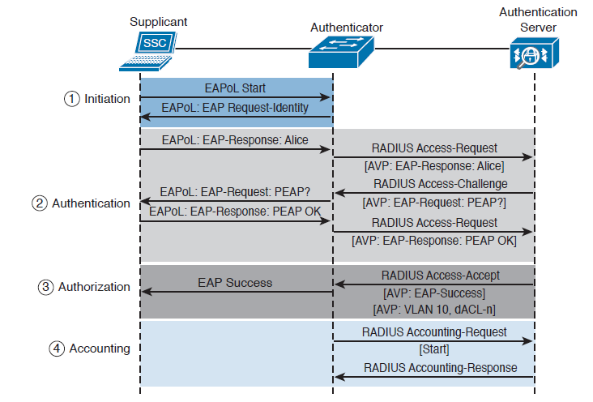
Identity and Access Control Implementation
Port-Based Access Control
802.1x
Session authorization
If the authentication server can authenticate the supplicant, it will send a RADIUS Access-Accept to the authenticator that includes additional authorization information such as VLAN, downloadable access control list (dACL), and so on.
The authenticator will send an EAP Success to the supplicant, and the supplicant can start sending traffic.
Session accounting
This represents the exchange of accounting RADIUS packets between the authenticator and the authentication server.
Notes:
In addition to these four phases, it is also very important that the session is correctly terminated. In the standard scenario, where the supplicant terminates the connection, it will send an EAPoL-Logoff message.

Slide 38
Identity and Access Control Implementation
Network Access Control List and Firewalling
Access Control List (ACL) is the most basic implementation of an access control.
When an ACL is applied to a network traffic, it is referred to as network ACL.
Devices such as routers, switches and firewalls include network ACL capabilities to control access to network resources.
As for port-based access controls, network ACLs and firewalling are usually seen as special cases of the ABAC model and also sometimes classified as identify-based or rule-based access control because they base the control decision on attributes such as IP or MAC addresses or Layer 4 information.
Notes:
Security group ACLs, on the other hand, are access lists based on the role of the subject trying to access a resource, and they implement role-based access control.

Slide 39
Identity and Access Control Implementation
Network Access Control List and Firewalling
Network ACLs can be implemented at various levels of the OSI model:
Layer 2 ACL
A Layer 2 ACL operates at the data link layer and implements filters based on Layer 2 information.
An example of this type of access list is a MAC access list, which uses information about the MAC address to create the filter.
Layer 3 ACL
A Layer 3 ACL operates at the networking layer.
Devices usually allow Layer 3 ACLs for different Layer 3 protocols, including the most used ones nowadays—IPv4 and IPv6.
In addition to selecting the Layer 3 protocol, a Layer 3 ACL allows the configuration of filtering for a protocol using raw IP, such as OSPF or ESP.
Layer 4 ACL
A Layer 4 ACL operates at the transport layer. An example of a Layer 4 ACL is a TCP or UDP-based ACL.
Typically, a Layer 4 ACL includes the source and destination. This allows filtering of specific upper-layer packets.

Slide 40
Identity and Access Control Implementation
Network Access Control List and Firewalling
ACL can also be implemented using VLAN Map. Security Group-based ACL and Downloadable ACL.
VLAN Map
VLAN ACLs, also called VLAN maps, are not specifically Layer 2 ACLs; however, they are used to limit the traffic within a specific VLAN.
A VLAN map can apply a MAC access list, a Layer 3 ACL, and a Layer 4 ACL to the inbound direction of a VLAN to provide access control.

Slide 41
Identity and Access Control Implementation
Network Access Control List and Firewalling
ACL can also be implemented using VLAN Map, Security Group-based ACL and Downloadable ACL.
Security Group-based ACL
A security group–based ACL (SGACL) is an ACL that implements access control based on the security group assigned to a user (for example, based on his role within the organization) and the destination resources.
The enforced ACL may include both Layer 3 and Layer 4 access control entries (ACEs).

Slide 42
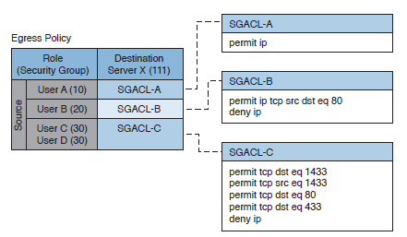
Identity and Access Control Implementation
Network Access Control List and Firewalling
ACL can also be implemented using VLAN Map, Security Group-based ACL and Downloadable ACL.
Security Group-based ACL
A security group–based ACL (SGACL) is an ACL that implements access control based on the security group assigned to a user (for example, based on his role within the organization) and the destination resources.
The enforced ACL may include both Layer 3 and Layer 4 access control entries (ACEs).

Slide 43
Identity and Access Control Implementation
Network Access Control List and Firewalling
ACL can also be implemented using VLAN Map, Security Group-based ACL and Downloadable ACL.
Downloadable ACL
A downloadable ACL (dACL), also called a per-user ACL, is an ACL that can be applied dynamically to a port.
The term downloadable stems from the fact that these ACLs are pushed from the authenticator server (for example, from a Cisco ISE) during the authorization phase.
When a client authenticates to the port (for example, by using 802.1x), the authentication server can send a dACL that will be applied to the port and that will limit the resources the client can access over the network.

Slide 44
Identity and Access Control Implementation
Network Access Control List and Firewalling
Firewalling
ACLs are stateless access controls because they do not maintain the state of a session or a connection.
A more advanced implementation of access control is provided by stateful firewalls, which are able to implement access control based on the state of a connection.
Firewalls often implement inspection capabilities that enforce application layer protocol conformance and dynamic access control based on the state of the upper-layer protocol.

Slide 45
Identity and Access Control Implementation
Network Access Control List and Firewalling
Firewalling
Next-generation firewalls go one step further and implement context-aware controls, where not only the IP address or specific application information are taken into account, but other contextual information, such as the location, the type of device requesting access, and the sequence of events, are taken into consideration when allowing or denying a packet.

Slide 46
Identity and Access Control Implementation
Network Segmentation
Network segmentation is a technique that is used in access controls design to separate resources either physically or logically.
Logical network segmentation can be implemented in several ways.
For example, a careful choice of IP addressing schema is one way to implement network segmentation.
Network segmentation by itself will not provide access control functionality, but facilitate the enforcement of access control policy at the ingress/egress points.

Slide 47
Identity and Access Control Implementation
Network Segmentation
Network Segmentation can be realised through:
VLAN
Firewall DMZ
VLAN
VLAN is a Layer 2 broadcast domain.
A careful plan of how ports or users are assigned to a specific VLAN can allow network segmentation and facilitate the implementation of access policy (for example, via network ACLs for traffic that needs to be routed across VLAN segments).
VLAN ACLs, also called VLAN maps, are not specifically Layer 2 ACLs; however, they work to limit traffic within a specific VLAN.
VLAN maps can apply MAC access lists or Layer 3 and Layer 4 access lists to the inbound direction of a VLAN to provide access control.

Slide 48
Identity and Access Control Implementation
Network Segmentation
Network Segmentation can be realised through:
VLAN
Firewall DMZ
VLAN
Private VLANs can also be used to implement VLAN partitioning and control the communication among ports belonging to the same VLAN. A private VLAN includes three types of ports:
Promiscuous: Devices attached to a promiscuous port can communicate with all ports within the switch, including isolated and community ports.
Isolated: Devices attached to an Isolated port can only communicate with the promiscuous port.
Community: Devices attached to a community port can communicate with the promiscuous port and with other devices in the same community.

Slide 49
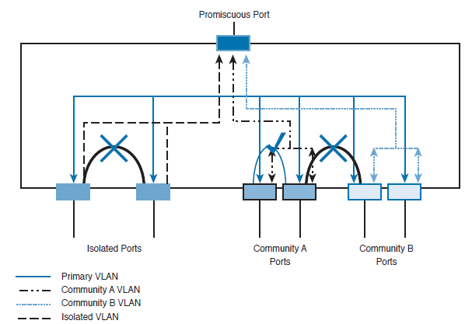
Identity and Access Control Implementation
Network Segmentation
Network Segmentation can be realised through:
VLAN
Firewall DMZ
VLAN
Private VLANs can also be used to implement VLAN partitioning and control the communication among ports belonging to the same VLAN. A private VLAN includes three types of ports:
Promiscuous: Devices attached to a promiscuous port can communicate with all ports within the switch, including isolated and community ports.
Isolated: Devices attached to an Isolated port can only communicate with the promiscuous port.
Community: Devices attached to a community port can communicate with the promiscuous port and with other devices in the same community.

Slide 50
Identity and Access Control Implementation
Network Segmentation
Network Segmentation can be realised through:
VLAN
Firewall DMZ
Firewall DMZ
Firewalls can be configured to separate multiple network segments (or zones), usually called demilitarized zones (DMZs).
These zones provide security to the systems that reside within them with different security levels and policies between them. DMZs can have several purposes; for example, they can serve as segments on which a web server farm resides or as extranet connections to a business partner.

Slide 51
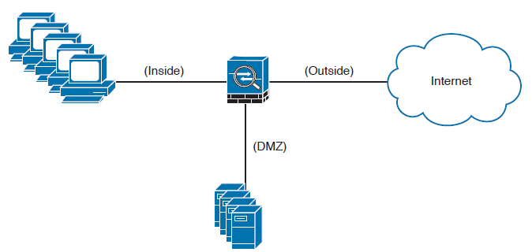
Identity and Access Control Implementation
Network Segmentation
Network Segmentation can be realised through:
VLAN
Firewall DMZ
Firewall DMZ
Firewalls can be configured to separate multiple network segments (or zones), usually called demilitarized zones (DMZs).
These zones provide security to the systems that reside within them with different security levels and policies between them. DMZs can have several purposes; for example, they can serve as segments on which a web server farm resides or as extranet connections to a business partner.

Slide 52
Identity and Access Control Implementation
Network Segmentation
Network Segmentation can be realised through:
VLAN
Firewall DMZ
Firewall DMZ
DMZs minimize the exposure of devices and clients on your internal network by allowing only recognized and managed services on those hosts to be accessible from the Internet.
DMZ hosts web servers that are accessible by internal and Internet hosts as shown in the previous figure.
In large organizations, you can find multiple firewalls in different segments and DMZs.

Slide 53
Identity and Access Control Implementation
Network Segmentation
Network Segmentation can be realised through:
VLAN
Firewall DMZ
Firewall DMZ
Firewalls can provide network segmentation while enforcing policies between those segments.
This figure shows a firewall is segmenting and enforcing policies between three networks in the overall corporate network.
The first network is the finance department, the second is the engineering department, and the third is the sales department. in the overall corporate network.
The first network is the finance department, the second is the engineering department, and the third is the sales department.

Slide 54
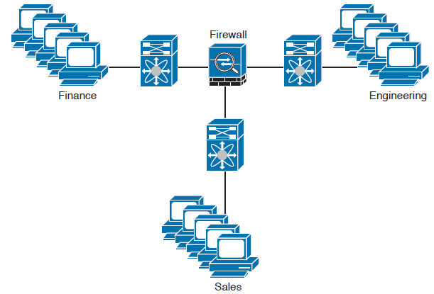
Identity and Access Control Implementation
Network Segmentation
Network Segmentation can be realised through:
VLAN
Firewall DMZ
Firewall DMZ
Firewalls can provide network segmentation while enforcing policies between those segments.
This figure shows a firewall is segmenting and enforcing policies between three networks in the overall corporate network.
The first network is the finance department, the second is the engineering department, and the third is the sales department. in the overall corporate network.
The first network is the finance department, the second is the engineering department, and the third is the sales department.

Slide 55
Questions

